Slide 1




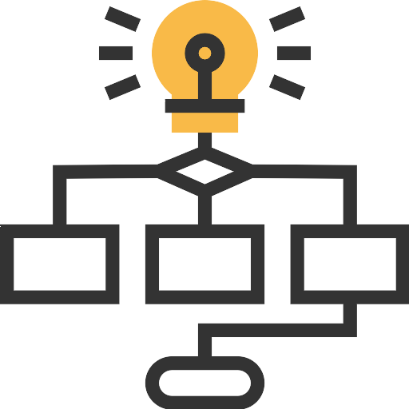
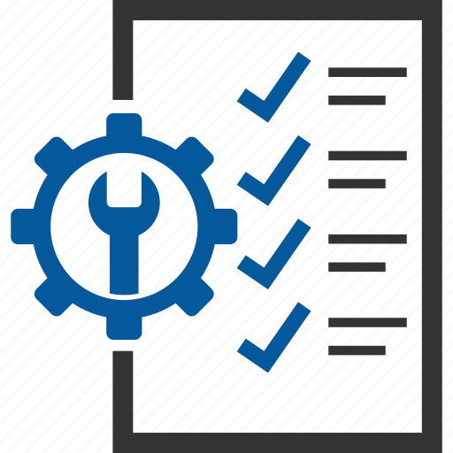

Base project management application architecture
Client
User
Admin
User
Digital Vendor
AMS Config. Support
App. Config & development.
Assign
Incidents
External AI Tools
Config Deployment
Cloud
Leverage AI services
Incident Management tool
User Interface
Tools
Collect app logs & Server Metrics.
Caching
Monitoring & Automation
UI Interfaces
Compression
Raise Incidents
Deploy Application Package
Client Essential Platforms
(External user/Provisioning)
Business Logic
Ideation
SLA Measurement
DevOps
API / Connectors / Adaptors
API / Connectors / Adaptors
Client user provisioning
Planning
Notifications
Tracking
Task Management
Backup File system and DB
Workflows
Rules
Data Layer
Backup
Client Security & Authentication
Authentication
Endpoint SSO
Security
API Integration
Monitor Endpoint security, Remote access, Vulnerability patch & Health check scans
Client Enterprise Network
(Applications/tools)

